Slide 1


Have you seen these?
How do they work?

Slide 2
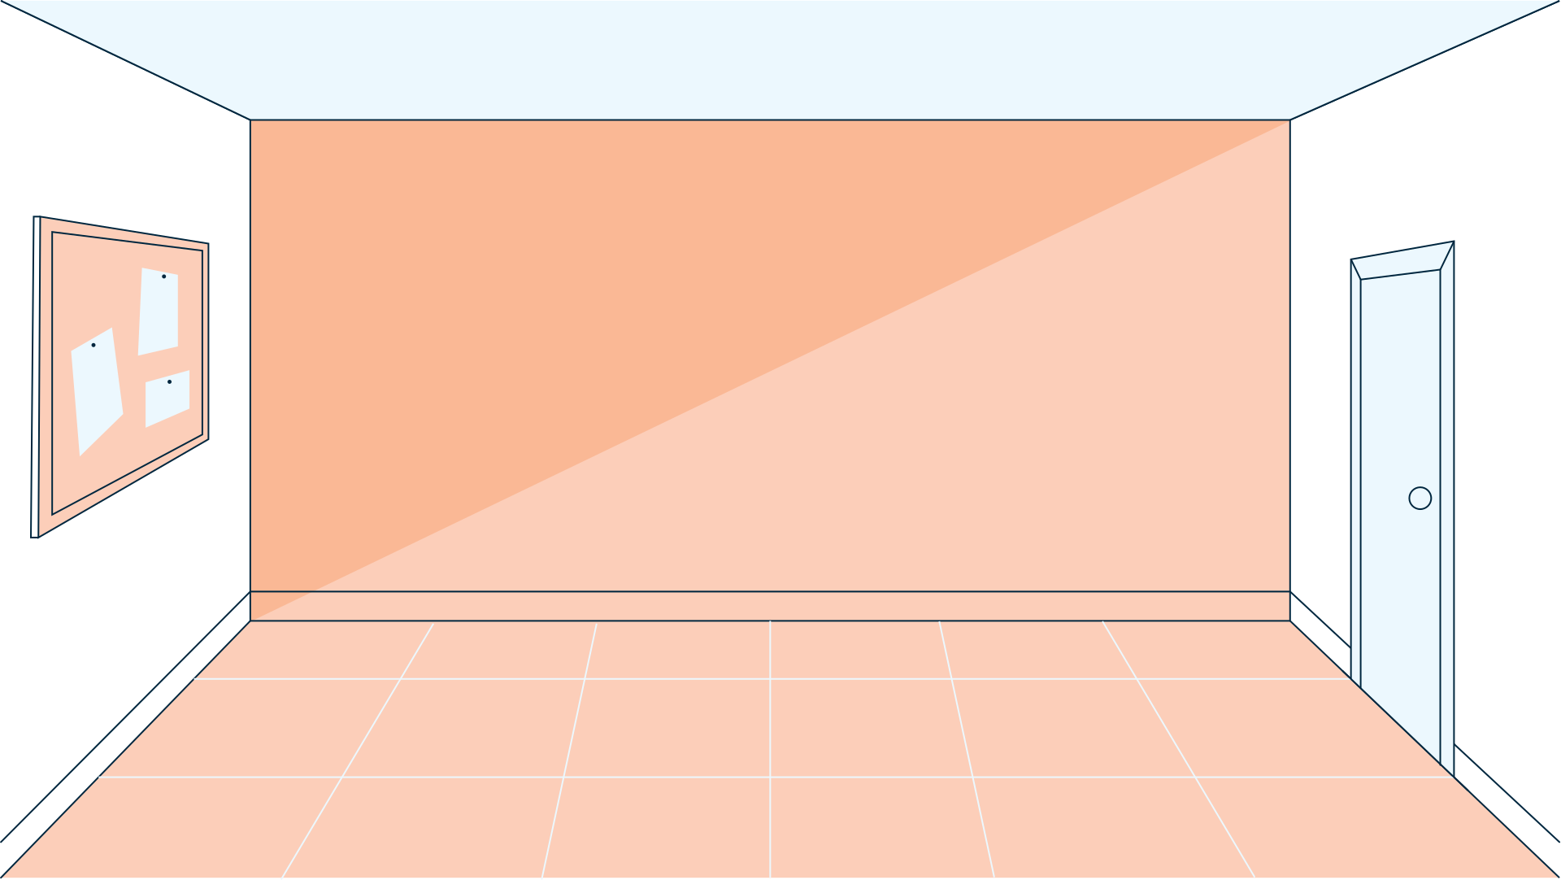


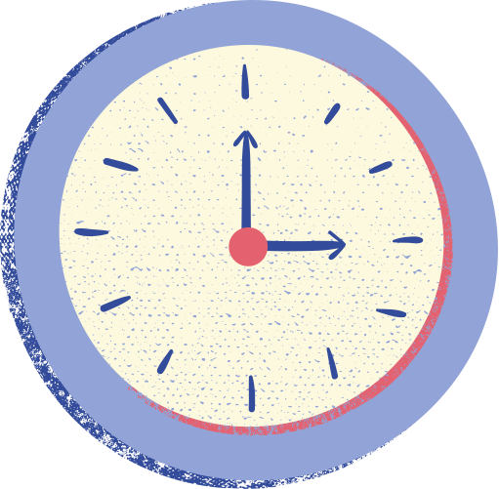






Motion Detection via mmWave Radars
Zuhayr Rahman Chowdhury

Slide 3

Table of Contents
1
Introduction
Background and Motivation
Objectives and Scope
4
Evaluation and Results
Comparison
2
System Design and Methodology
Technology Overview
System Setup
Experimental Setup
5
Conclusion
Final Observations & Analysis
Challenges
Future Improvements
3
Preliminary Results and Analysis
Machine Learning Classifiers Used
Preliminary Results
Analysis
6
Summary

Slide 4
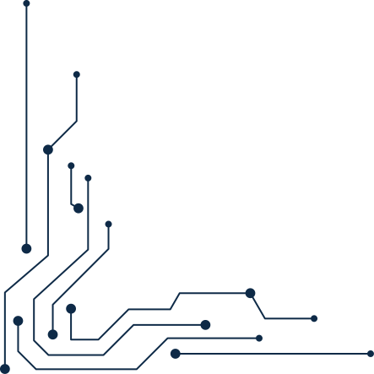



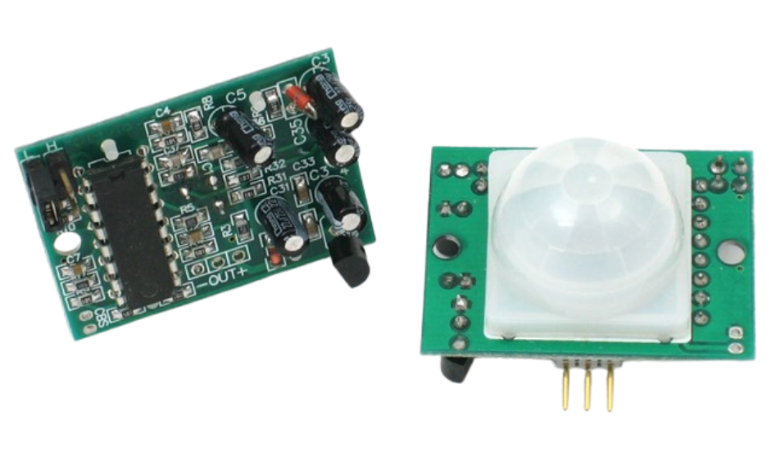
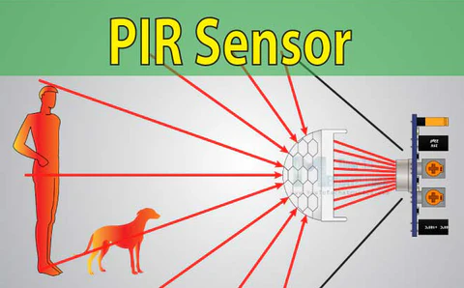


Introduction
Background and Motivation
Passive Infra-Red (PIR) Sensors
How do these work?

Slide 5



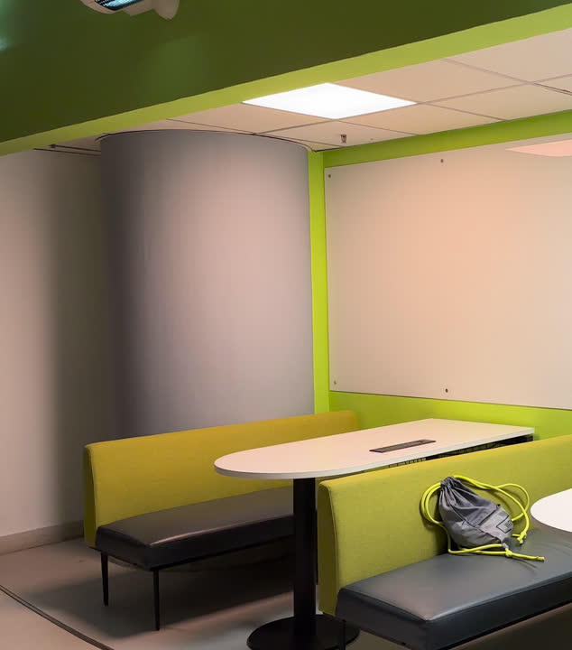
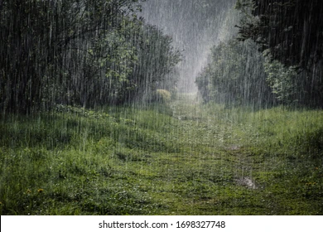
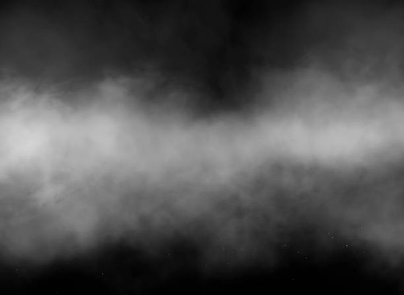

However...
Traditional PIR Sensors have a few limitations

Slide 6

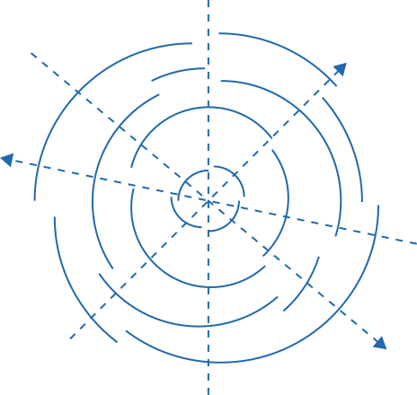
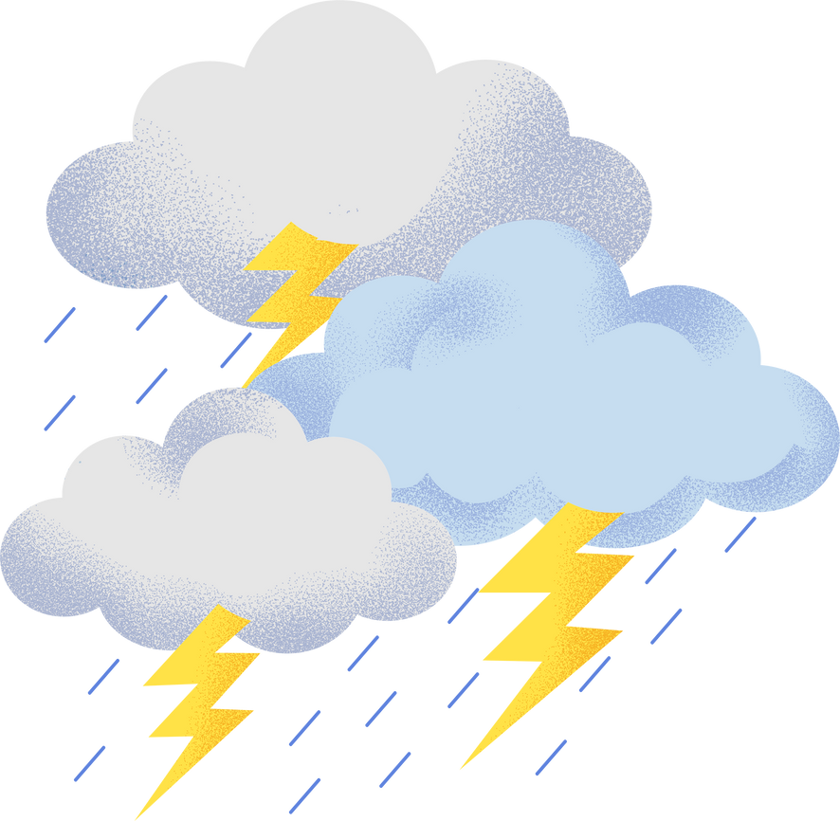

Passive Infra-Red (PIR) Sensors
Limited Range
Unreliable in adverse weather conditions

Slide 7

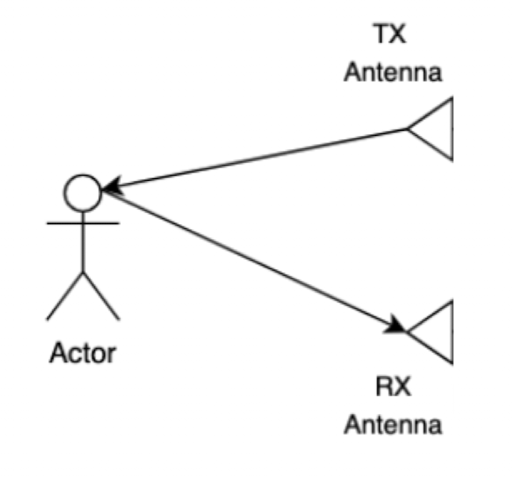

mmWave Radar Technology Overview
Advantages:
Able to detect stationary objects
Unaffected by environmental factors
More accurate & reliable

Slide 8




Objectives and Scope
A Modern mmWave Radar Motion Detection System
Choosing Appropriate Hardware, Designing Algorithms & Integration
Final Report, Presentation & Live Demonstration

Slide 9





System Design and Methodology

Slide 10

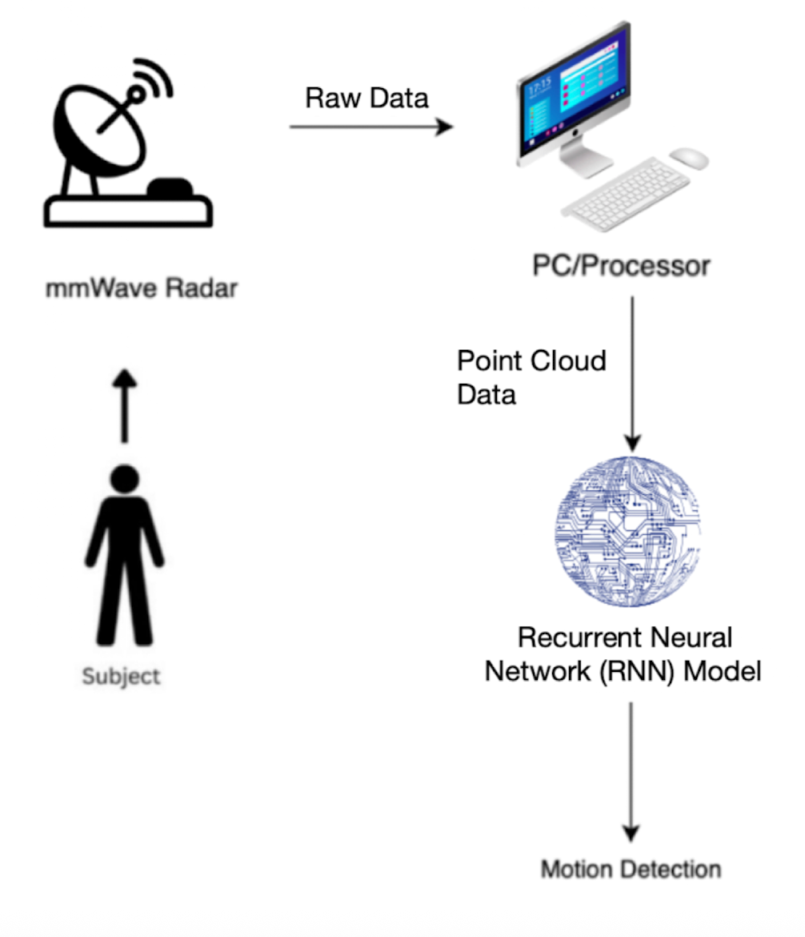
System Setup

Slide 11
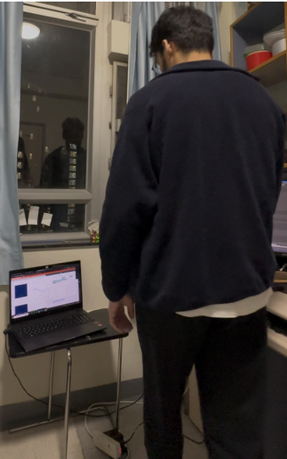
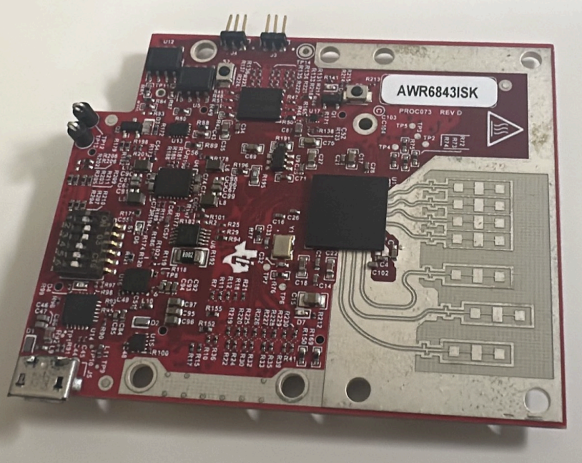
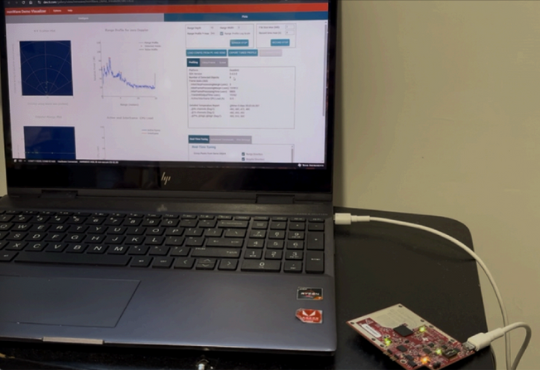

Experimental Setup
PC connected to mmWave Radar
Sample Experiment
mmWave Radar

Slide 12
Preliminary Results and Analysis

Slide 13
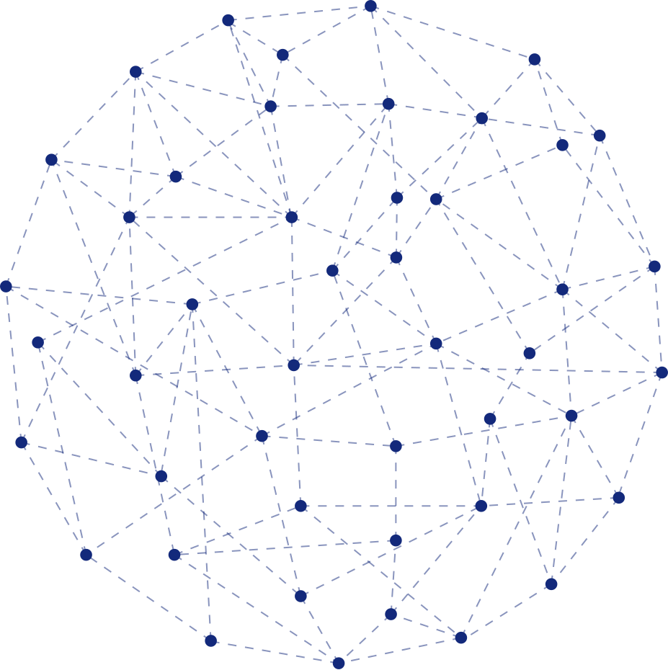
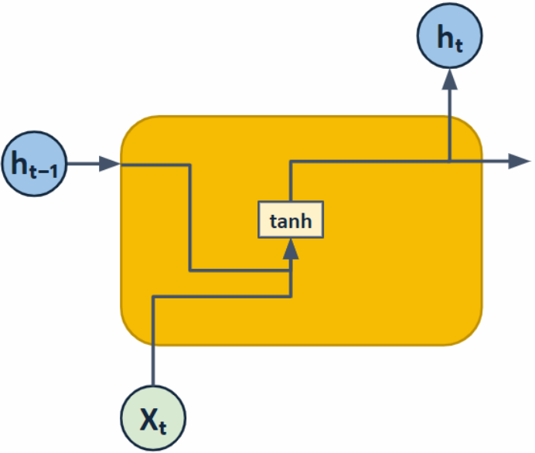




Machine Learning Classifiers Used: Recurrent Neural Network (Traditional/Vanilla RNN)

Slide 14
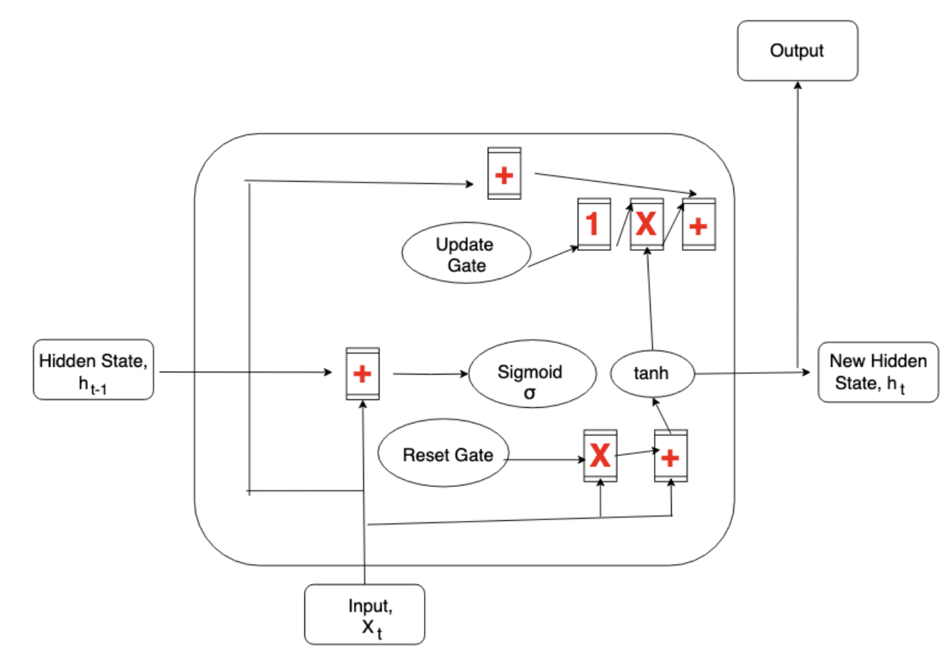
Machine Learning Classifiers Used: Gated Recurrent Units (GRU)

Slide 15
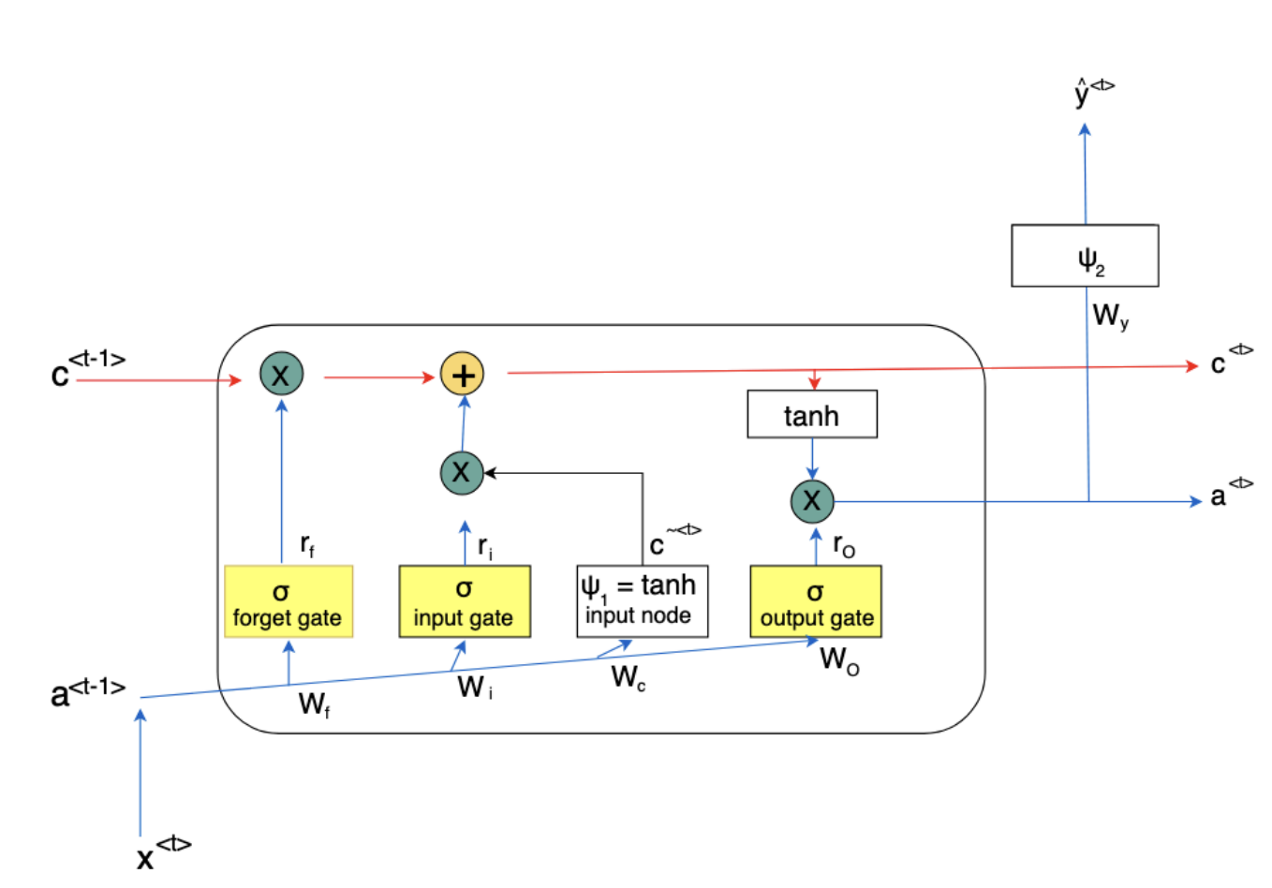
Machine Learning Classifiers Used: Long Short-Term Memory (LSTM)

Slide 16

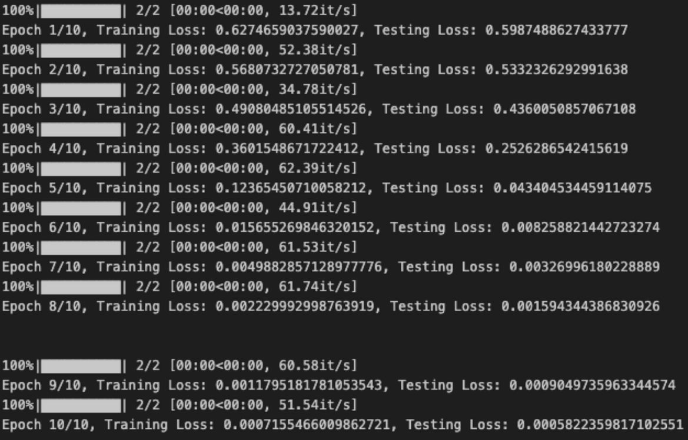
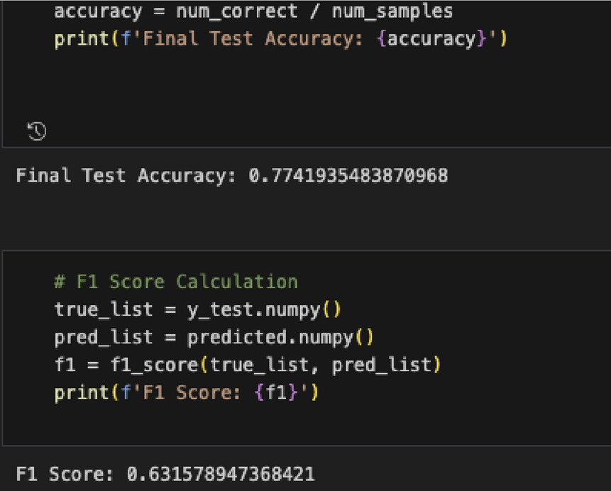

Preliminary Results Using LSTM
Low Accuracy and F1 Scores

Slide 17
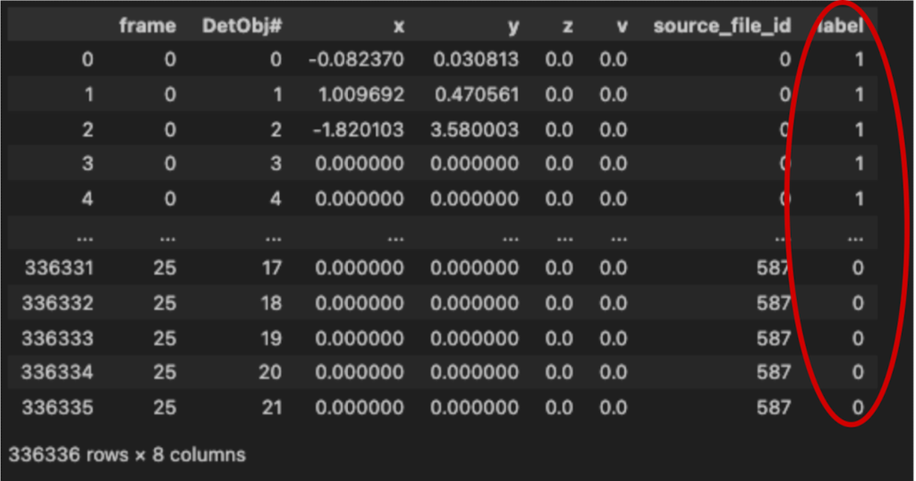


Analysis
Low Accuracy and F1 Scores were due to improper assignment of labels to individual points rather than point clouds

Slide 18
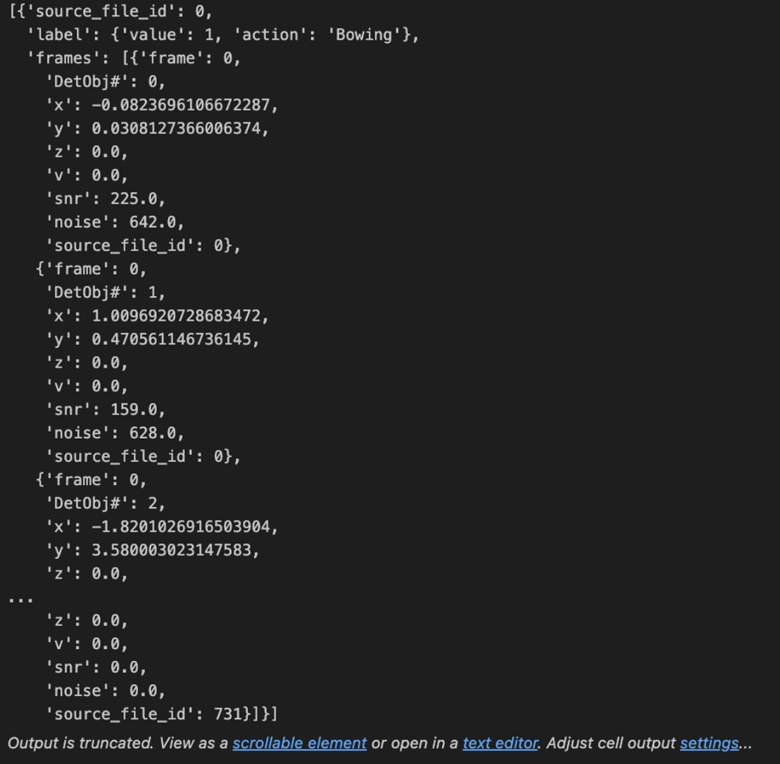

Analysis
Proper assignment of labels to individual point clouds

Slide 19
Evaluation and Results

Slide 20
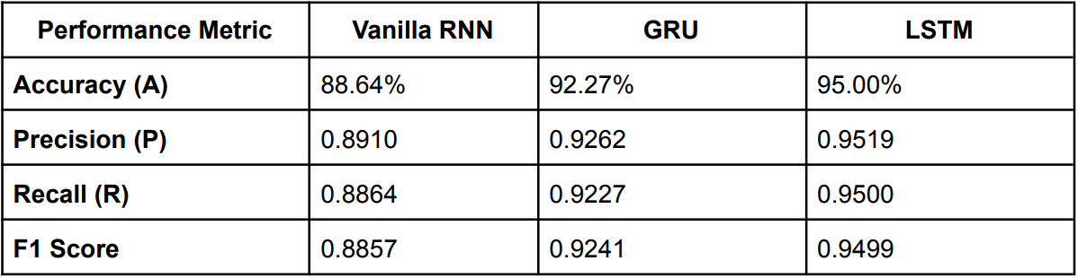
Comparison

Slide 21
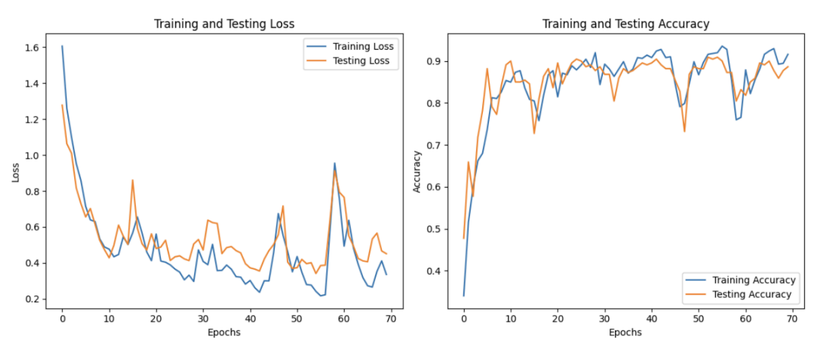
Comparison
Vanilla RNN:
Considerable spikes in training and testing loss around epochs 45 and 60
Sudden drops in testing and training accuracies around epochs 15, 47 and 58

Slide 22
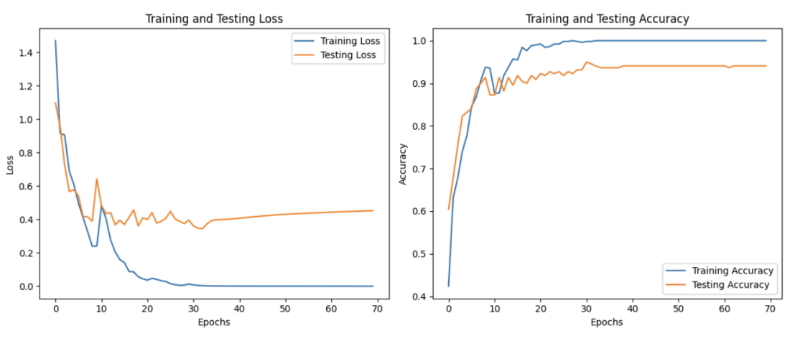
Comparison
GRU:
Large spike in training and testing loss around 10 epochs

Slide 23
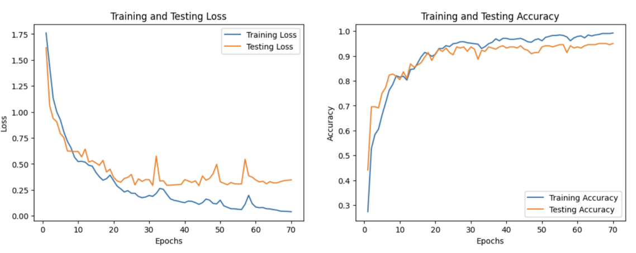
Comparison
LSTM:
No considerable spikes in training and testing loss

Slide 24
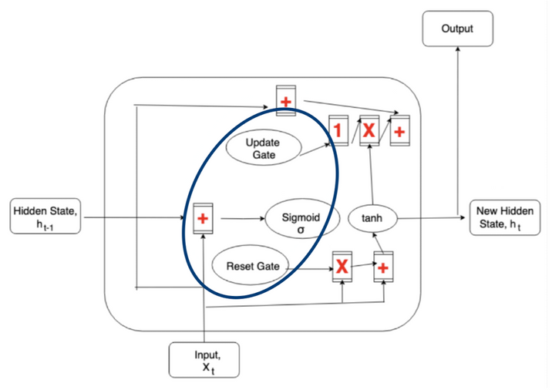
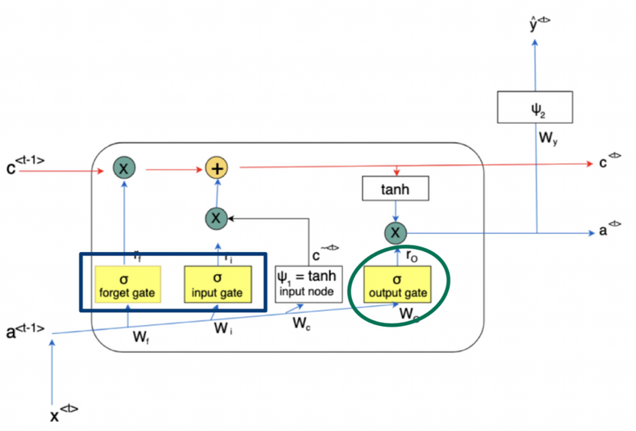


Comparison
Vanilla RNN
GRU
LSTM

Slide 25
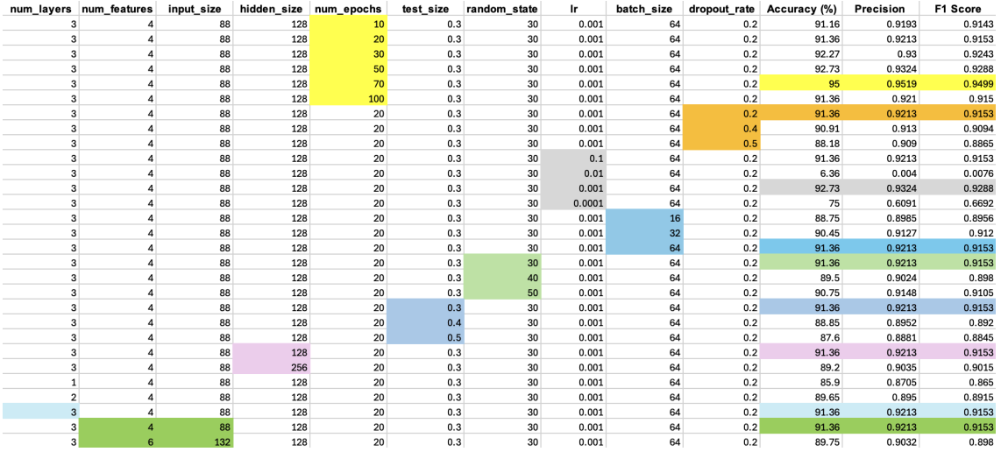
LSTM Parameters Selection
num_layers=3
num_features=4
input_size = 88 hidden_size = 128
num_epochs = 70
test_size = 0.3 random state = 30 lr=0.001
batch_size = 64
dropout_rate = 0.2

Slide 26

Conclusion

Slide 27
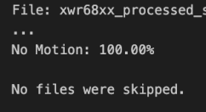
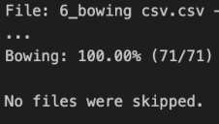
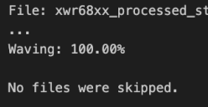
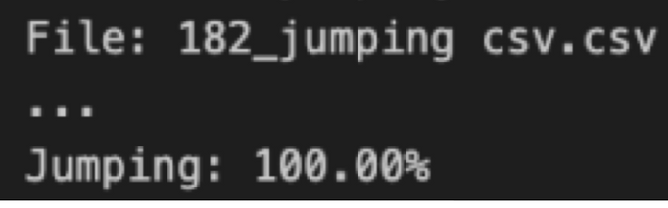
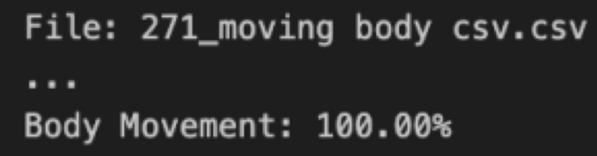
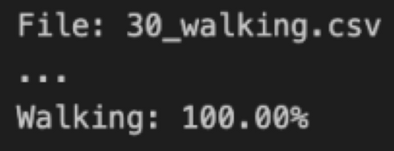
Final Observations
Testing On New Data:
LSTM’s impressive capability to accurately classify motion/ no motion

Slide 28




Challenges
Difficulty setting up the radar due to PC incompatibility
2. Limited dataset due to a lack of subjects and environments, time constraints, and the tedious nature of data collection

Slide 29




Future Improvements
Creating an enriched and comprehensive dataset
2. Real-Time Detection
3. Additional Derived Features (acceleration, angular velocity)

Slide 30

Summary

Slide 31
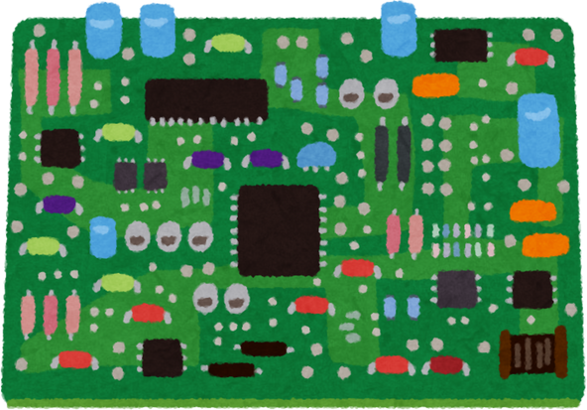
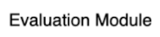
Summary

Slide 32
Comparison

Slide 33
Comparison
Vanilla RNN
GRU
LSTM

Slide 34
Thank You!

